Slide 1
Data File operations

Slide 2
Introduction
The stream that supplies data to the program is known as input stream.
The stream that receives data from the program is known as output stream.
The input operation involves the creation of an input stream and linking it with the program and the input file.
Similarly, the output operation involves establishing an output stream with the necessary links with the program and the output file.

Slide 3
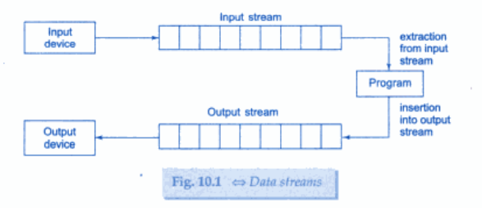

Slide 4
Classes for File stream operations
These include ifstream, ofstream and fstream.
These classes are derived from fstreambase and from the corresponding iostream class.
ifstream class provides input operations and is used to read information from files.
ofstream class provides output operations and is used to create files and to write information to files.
fstream class has the capabilities of both ofstream and ifstream which means it can create files, write information to files, and read information from files.

Slide 5
Opening and Closing a file
If we want to use a disk file, we need to decide the following things about the file and its intended use:
  Suitable name for the file
  Data type and structures
  Purpose
  Opening method

Slide 6
For opening a file, we must first create a file stream and then link it to the filename.
A file stream can be defined using the classes ifstream, ofstream and fstream that are contained in the header file fstream.
The class to be used depends upon the purpose, that is, whether we want to read data from the file or write data to it.
The file can be opened in two ways:
  Using the constructor function of the class
  Using the member function open() of the class

Slide 7
Opening file using Constructor
Constructor is used for initializing object.
Filename initialize the file stream object.
This involves the following steps:
  Create the file stream object to manage the stream using the appropriate class.
  The class ofstream is used to create the output stream and the class ifstream to create the input stream.
  Initialize the file object with the desired filename.

Slide 8
ofstream outfile(“result”); // opens file for output only
This statement opens the file results and attaches it to the output stream outfile for writing.
ifstream infile(“result”); // opens file for input only
This statement opens the file result and attaches it to the input stream infile for reading.
outfile.close(); and infile.close(); disconnects the file salary.

Slide 9
Opening file using open()
It is used to open multiple files that use the same stream object.
Syntax:
  file-stream-class stream-object;
  stream-object.open(“filename”);
Example:
  ofstream outfile;
  outfile.open(“data.txt”);
  .
  .
  .
  outfile.close();
  outfile.open(“role.txt”);
  .
  .
  .
  outfile.close();

Slide 10
In this example two files are opened in sequence for writing data.
First file is closed before opening the second one.
This is required as stream can be connected to only one file at a time.

Slide 11
Detecting END-OF-FILE
It is necessary for preventing any further attempt to read data from the file.
An ifstream object returns a value 0 if any error occurs in the file operation including the end-of-file condition.
eof() is a member function of ios class. It returns a non zero value if end of file is encountered.

Slide 12
File Modes
General syntax of open():
  stream-object.open(“filename”,mode);
  The second argument specifies the purpose for which the file is opened.
  As we were not specifying the second argument in the previous case. So it was taking the default argument.
  The default values are as follows:
    ios:in for ifstream
    ios::out for ofstream function.

Slide 13
File mode parameters are:
  ios::app – append to end-of-file
  ios:: ate – go to end of file on opening
  ios:: binary – binary file
  ios:: in – open file for reading only
  ios:: nocreate – open fails if the file does not exist
  ios:: noreplace – open fails if the file already exists
  ios:: out – open file for writing only
  ios:: trunc – delete the contents of the file if it exists

Slide 14
File Pointers
Every file maintains two pointers known as file pointers.
They are get_pointer (in input mode file) and put_pointer (in output mode file) which tells the current position in the file where reading or writing will takes place.
Everytime an input or output operation takes place, the appropriate pointer is automatically advanced.

Slide 15
Manipulation of file pointers
The movement of file pointers can be controlled by the following functions:
  seekg(); moves get pointer to a specified location
  seekp(); moves put pointer to a specified location
  tellg(); gives the current position of get pointer
  tellp(); gives the current position of put pointer

Slide 16
ifstream fin;
ofstream fout;
fin.seekg(30); // will move the get_pointer to byte number 30 in the file
fout.seekp(30); // will move the put_pointer to byte number 30 in the file

Slide 17
Consider the following example:
  ofstream fileout;
  fileout.open(“hello”,ios::app);
  int p= fileopu.tellp();
On execution the output pointer is moved to the end of file hello and p represents the number of bytes in the file.

Slide 18
Specifying the Offset
Seek function can also be used with two arguments as follows:
  seekg(offset,refposition);
  seekp(offset,refposition);
The parameter offset represents the number of bytes the file pointer is to be moved from the location specified by the parameter refposition.

Slide 19
The refposition takes one of the following three constants defined in the ios class:
  ios::beg:- start of the file
  ios::cur:- current position of the pointer
  ios::end:- end of the file

Slide 20
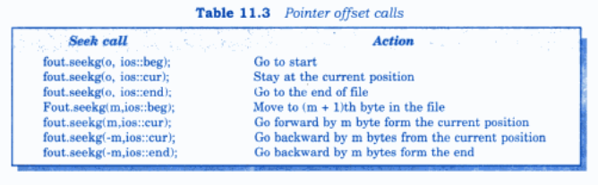

Slide 21
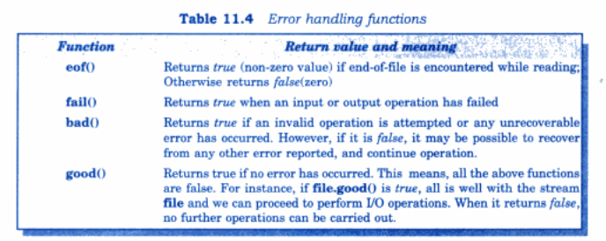
Stream state member functions

